Slide 1

Working with Assistants Part 13: Working with File Search & Vector Stores

Slide 2
Joining Vector Stores to Assistants
Time to get the two together!

Slide 3

Assistants and Vector Stores
ASSISTANT

Slide 4



Notes:
https://www.youtube.com/channel/UC35ZpwldGw7ZJ5R-2sLijzw

Slide 5
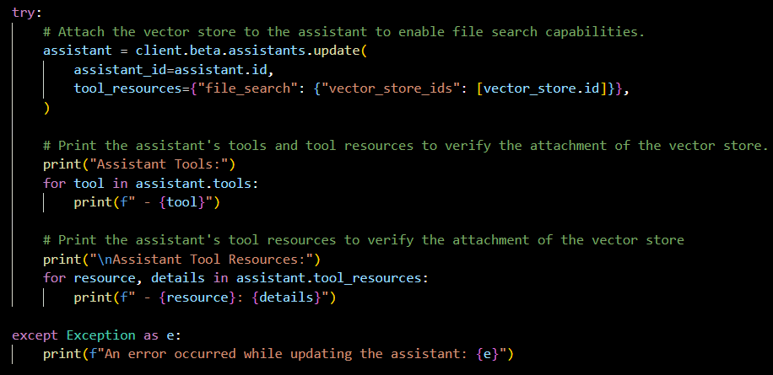
Demo: Attaching a Vector Store to an Assistant

Slide 6
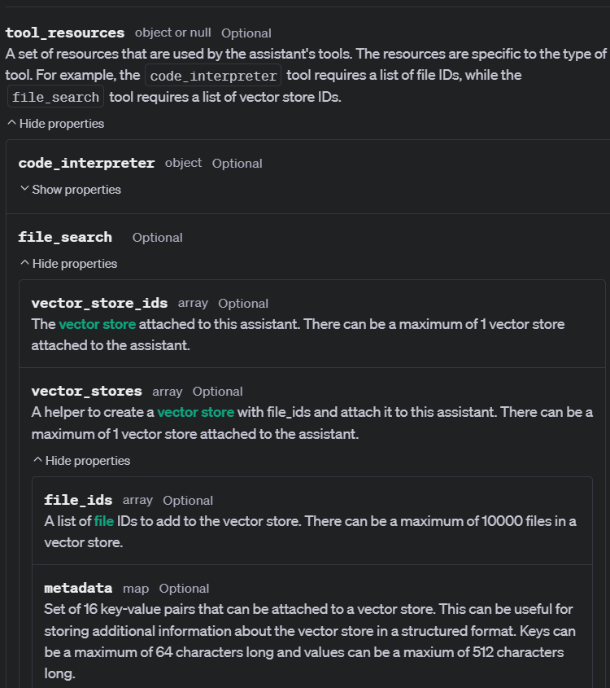
Creating an Assistant and Vector Store at the Same Time

Slide 7
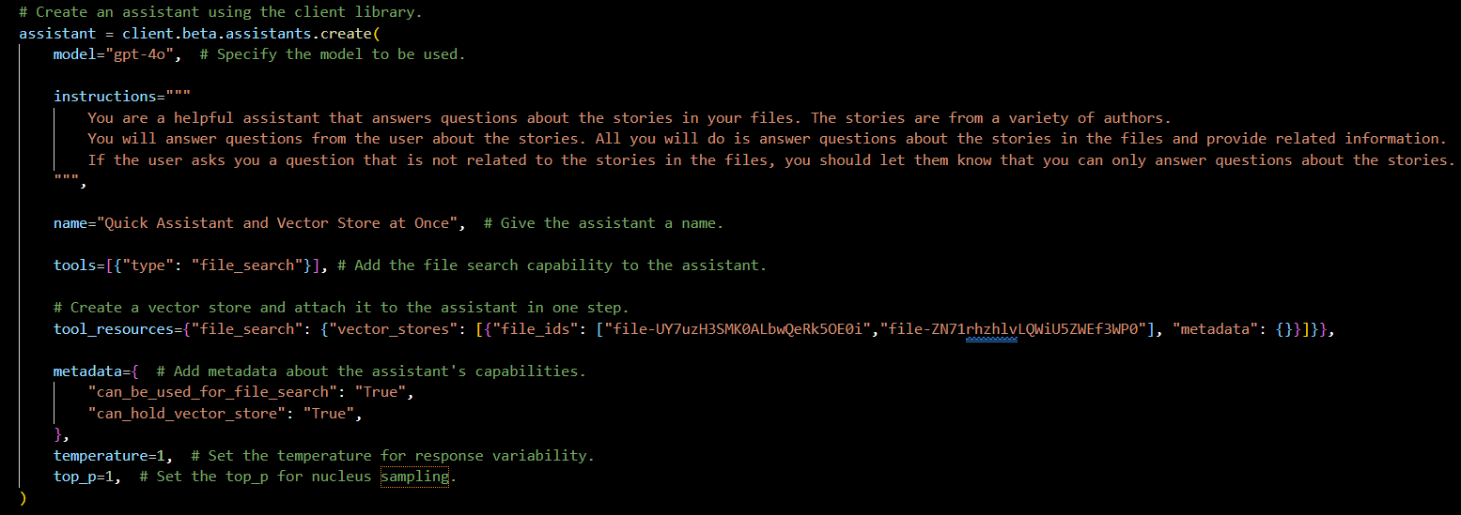
Demo: Creating Assistant and Vector Store Simultaneously

Slide 8
Creating a Vector Store with a Thread
Vector Stores Can Be Attached to Threads

Slide 9
Threads and Vector Stores
THREAD

Slide 10
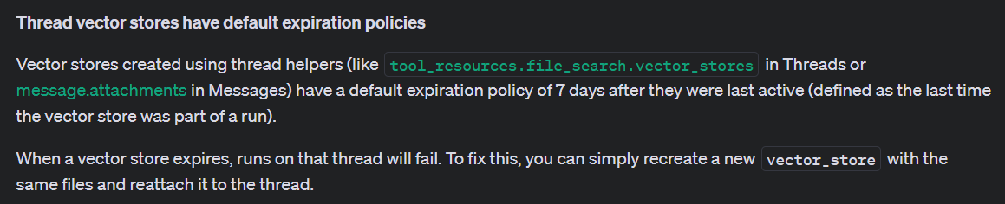
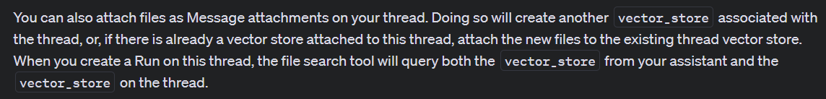
Notes:
https://platform.openai.com/docs/assistants/tools/file-search/step-4-create-a-thread

Slide 11
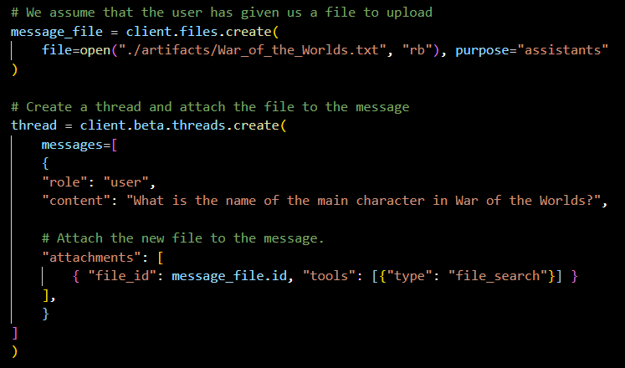
Demo: Creating a Thread with a Vector Store with Message File Upload

Slide 12
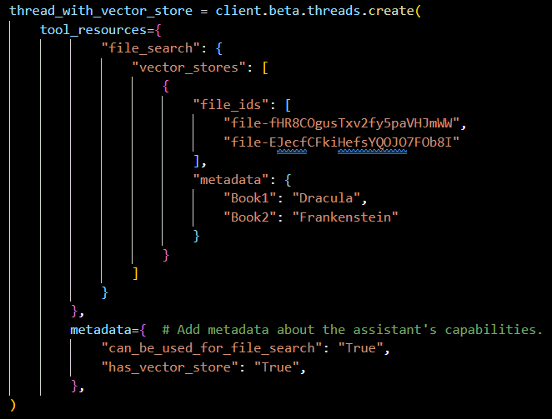
Demo: Creating a Thread with a Vector Store

Slide 13
Getting the Results
Actually Using the Information

Slide 14
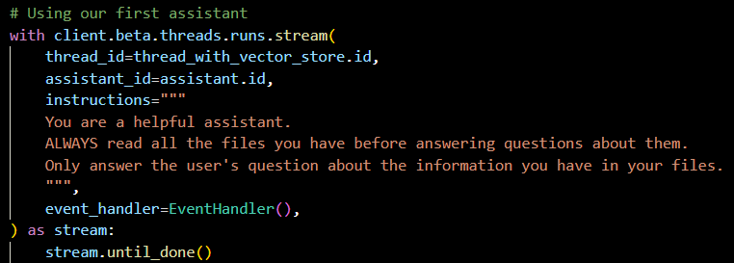
Demo: Streaming the Results

Slide 15
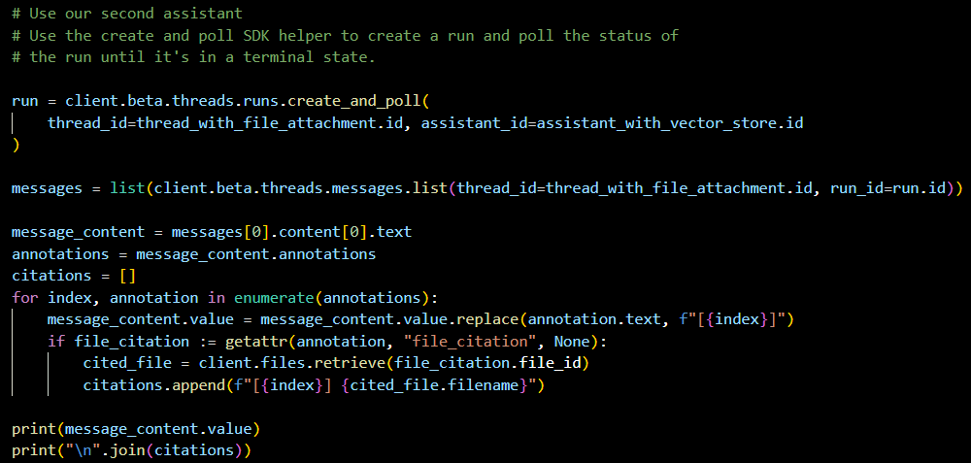
Demo: Getting Results without Streaming

Slide 16
